Slide 1


Business Strategy

Slide 2
About Shopify
History
Founders: Tobias Lütke (CEO), Daniel Weinand, and Scott Lake
Founded in 2006
HQ: Ottawa, Canada
Mission
Improve commerce for everyone by empowering businesses to build and scale their online presence
Vision
To be the backbone of internet commerce by providing merchants with tools to win in digital-first world
2019
2020
2022
2023
2024
$7.1 Billion revenue
$132 Million net income
~8300 employee
$2.16 Billion Q3 revenue (26% YoY)
5.6 million active stores across > 175 countries
Annual 2024 report TBD: Feb 11
$1.57 Billion revenue
$2.93 Billion revenue
$5.6 Billion revenue

Slide 3
Key Products and Services
E-Commerce Platform: Intuitive website builders with customizable templates.
Point of Sale (POS) Systems: Integration for physical retail operations
Payment Solutions: Shopify Payments, multi-currency processing, and financing options.
Marketing and Analytics: Omnichannel, campaign management, and performance dashboards
App Ecosystem: Thousands of third-party integrations to streamline logistics, inventory, and customer engagement
Finance: One-stop for all thing finance for merchants i.e credit, investment, tax, etc.

Slide 4
Shopify Market and Trends
Market Positioning: a dominant player in the e-commerce technology space, catering to both small-scale entrepreneurs and major brands
Target Customer Base: Fashion brands such as Fashion Nova, Kith, Gymshark
Industry Trends
E-Commerce Growth: significant adoption due to the shift toward online shopping, particularly post-pandemic
Consumer Preferences: merchants leveraging data analytics and AI for personalized shopping experiences
Direct-to-Consumer (DTC): The platform supports a growing trend of brands bypassing traditional retail models

Slide 5

Technology Footprint Assessment
Peak of Inflated Expectations
AR/VR Virtual Try-Ons
Generative AI (Shopify Magic)
Headless Commerce
Plateau of Productivity
AI-driven demand forecasting
Social Commerce Integrations
Real-time inventory tracking
Data analytics
AI-enabled commerce assistant (Shopify Sidekick)
IoT Integrations
Cloud Infrastructure
AI-driven recommendations
Blockchain integrations for cryptocurrency
E-commerce automation
Slope of Enlightenment
AI Customer Service Chatbots
Innovation Trigger
Trough of Disillusionment

Slide 6

Strategic Position: Porter’s Five Forces
Industry Rivalry
Bargaining Power: Buyers
Threat of New Entrants
Threat of Substitutes
Bargaining Power: Suppliers
Level: Very High
Shopify brands prefer control, but Amazon’s logistics and reach create pressure.
Amazon is replicating Shopify’s model (Selz acquisition, Project Santos).
Level: High
Shopify must innovate with AI, automation, and omnichannel tools to stay competitive.
Social commerce growth intensifies platform competition.
Level: Moderate to High
Shopify Plus enables scaling, but big brands like Shein, Zara dominate.
Shopify’s rapid expansion encourages new market players.
Level: Moderate
Shopify’s unique ecosystem offers branding and logistics advantages.
Amazon’s "Buy with Prime" challenges Shopify’s market position.
Level: Low
Diverse supplier network: Merchants can switch suppliers easily, reducing dependence.
Big brands (H&M, Zara) have more supplier leverage due to bulk purchasing.

Slide 7
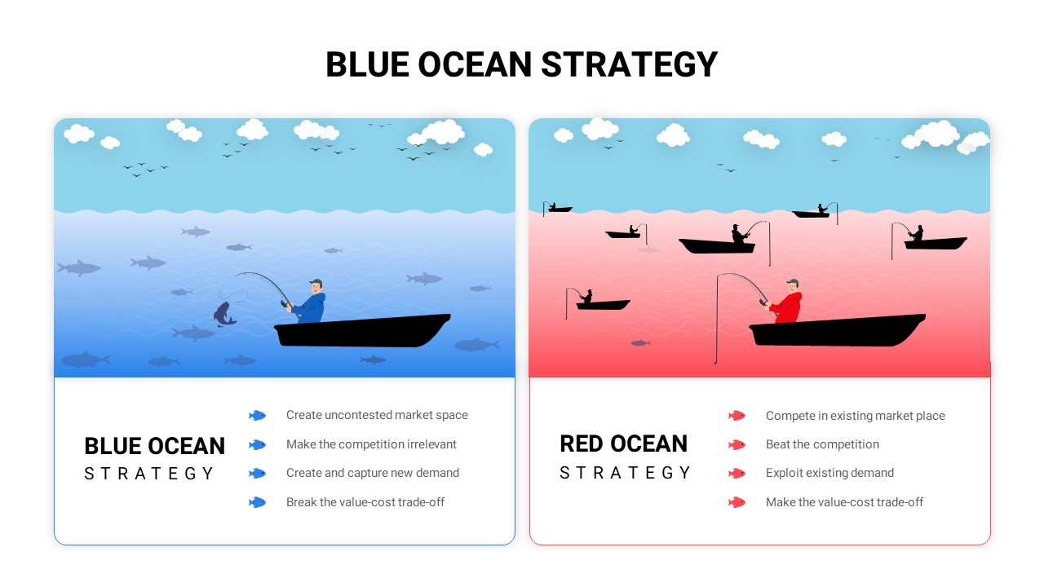





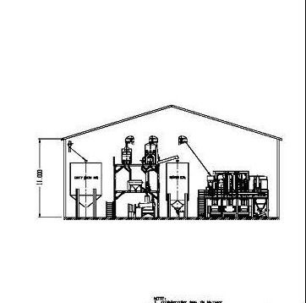


Red Ocean vs Blue Ocean
Improve Shopify Fulfillment Network efficiency & partnerships with regional logistics providers to expedite dropshipping delivery time and cost
Blockchain to unlock new, untapped opportunities in fast fashion by enhancing transparency, security, and ownership in e-commerce
Transform the platform to support hyper-personalized fashion discovery and enhanced advertising engine for trend-based product curation
Embed the power of AR/VR technology into the fashion industry with unique virtual try-on features as a service baked into the platform tools
Develop a Fast Fashion Merchant Hub with bulk order processing & wholesale-friendly features for larger merchants
Expand into emerging markets by connecting exquisite small scale regional fashion to the global supply chain providing wider visibility
AI-powered fashion trend insights for merchants to align inventory with demand based on active forecasting of trends
Sustainable fast fashion initiative with verified eco-friendly supply chains and optimized carbon neutral practices by all the partners
Notes:
Fast fashion requires ultra-fast delivery, but our Shopify Fulfillment Network (SFN) is still growing. We are not yet able to gain as much momentum on the demand and supply given majority of our merchants are SME’s. Competitors like Shein, H&M, Zara are more evolved with respect to managing and distributing.
Expand regional micro-fulfillment centers to expedite shipping for fashion merchants.
Partner with third-party logistics (3PL) providers specializing in fashion (e.g., automated fashion warehouses, on-demand inventory management).
Implement AI-driven demand forecasting to optimize stock levels and reduce shortage.
We might be an ecommerce behemoth, but still a smaller advertising player compared to Amazon. Merchants resist the Shop App because it lacks many advanced advertising controls that increase discovery. Amazon, Shein, and other fast fashion giants already dominate fashion discovery and consumer engagement with their platforms.
- Transform the Shop App into a personalized fashion discovery engine instead of a competitive marketplace like amazon.
- Allow merchants to curate storefront-like experiences within the app (e.g., exclusive lookbooks, featured collections, trend-based shopping).
We mainly serve SMEs, while large-scale fast fashion merchants rely on vertically integrated supply chains or marketplaces.

Slide 8
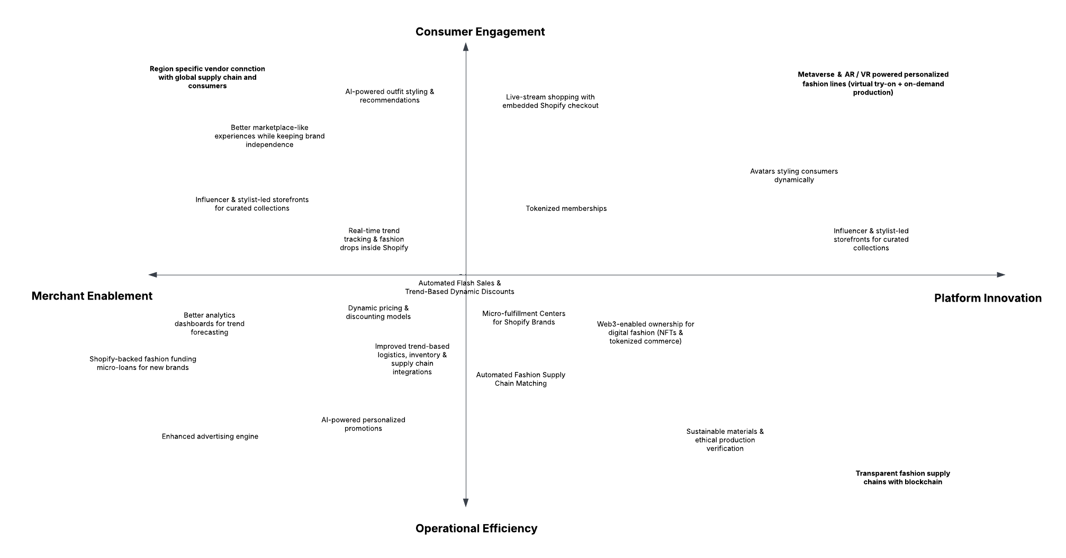
Opportunity Landscape

Slide 9

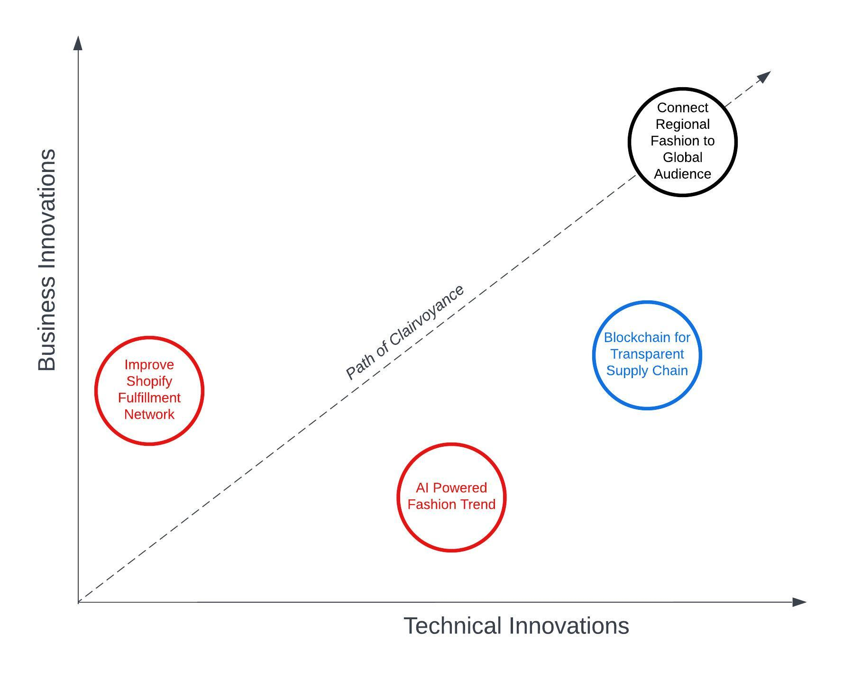
Final Recommendation
• Improve Shopify Fulfillment Network: Enhancing Shopify’s logistics and supply chain to better support merchants, reduce delivery times, and optimize fulfillment efficiency.
• AI-Powered Fashion Trend: Leveraging AI to predict fashion trends, optimize inventory, and personalize shopping experiences based on consumer data.
• Blockchain for Transparent Supply Chain: Utilizing blockchain technology to enhance supply chain transparency, reduce fraud, and provide traceability for ethical sourcing in the fashion industry.
• Connect Regional Fashion to Global Audience:
Shift from a traditional marketplace to a curated cultural commerce platform
AI-driven cultural profiling to recommend regionally inspired products
Empower independent brands through social commerce, influencer collaborations, and cross-border logistics
Differentiate itself from mass-market competitors like Amazon and Shein

Slide 10
THANKS!
Zachary Walsh (CDG)
Maurya Shah
Poorav Desai
Adit Khalkar
Pratik Nesarkar
Dhiraj Manicketh

